Slide 1
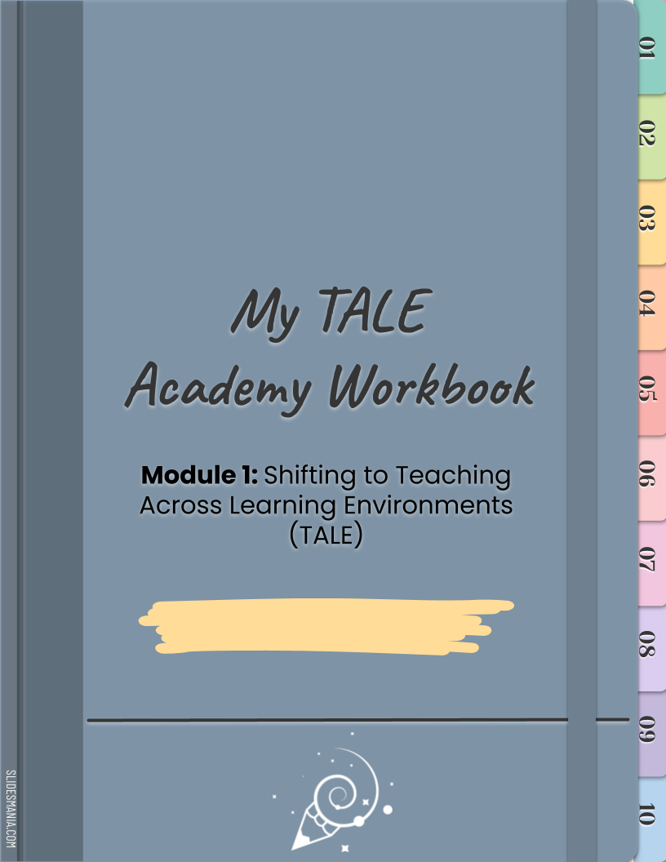
Enter your name here.

Slide 2
Introduction
Welcome to your Digital Workbook!
This digital workbook is your place to complete the activities for Module 1: Shifting to Teaching Across Learning Environments (TALE). This workbook is a living document for your own personal use and learning. Your notes and your work within this resource are visible only to you.
If using Google Slides your changes will update automatically. If you choose to convert to PPT remember to save your work!
This module has a total of 10 sessions. As you complete each session within the TALE Academy, you will return to and use this digital workbook to complete the activities assigned to you.
Advance to the next page to learn some tips for using this workbook.
Enjoy the learning journey!

Slide 3
Workbook Tips
Keep Your Workbook Handy
As you progress through the TALE Academy, keep your copy of the workbook open for easy access.
Navigation: Using the Workbook Tabs
The colorful, numerical tabs on the right of the workbook are hyperlinked to the corresponding session for easy access. Left click on the first tab that reads “01.” A pop-up will provide a hyperlink to Session 01. Click that hyperlink to be taken to Session 01. Your first activity in Module 1, Session 1 is Activity 1.1.1. In this case, you would click on the “01” tab on the right to jump to Session 1 and scroll to Activity 1.1.1.
Navigation: Returning to the Table of Contents
Page 7 is the Table of Contents, which lists each of the 10 session titles. Throughout the workbook you will see this icon:
To return to the Table of Contents, click on this icon to access the Table of Contents hyperlink.

Slide 4
CTLE Credit & Micro-Credentials
Earning CTLE Credits
Upon completion of each session within the TALE Academy you will be prompted to complete a short quiz. Upon completion you will be eligible to receive Continuing Teacher and Leader Education (CTLE) credits.
NOTE: In order to receive CTLEs your learning must be associated with a CTLE provider.
Deeper Learning - Implementation at a Micro-Credential Level
You also have the option to complete activities that lead to deeper learning, learning at a micro-credential level. At this
level you will extend your knowledge and skill to the practice and application level. Deeper learning activities focus on building skills and competencies related to the topics covered in each session. Look for the MC icon in the workbook highlighting activities that correspond to deeper learning. The 3rd Activity in every session provides opportunities for deeper learning.
NOTE: In order to receive micro-credentials your learning must be associated with a micro-credential provider.

Slide 5
Key Terms
At the start of each session in Module 1, we establish the key terms and working definitions relevant to the session.
Where did these working definitions come from?
The TALE Academy team developed the working definitions by drawing from multiple sources, including research (e.g., peer-reviewed studies), emerging discourse (e.g., newspaper and blog articles), field use (particularly from Phase 1 implementation of the TRLE project), and policy reviews.
Can I take notes on the key terms throughout the module?
On the same page of this workbook on which we define key terms for each session, there is space for you to add to and refine these definitions, put them in your own words, or note examples related to the terms. This is not an activity that you are required to do. The key terms are for reference purposes only.

Slide 6
Stickers
You can copy and paste the stickers below to note important text in your workbook. This is optional.

Slide 7
Table of Contents
SESSION | CONTENTS
01
From Emergency Remote Teaching (ERT) to Teaching Across Learning Environments (TALE)
02
The 4 Constants Across Learning Environments
03
Building Classroom Community Across Learning Environments
04
Engaging Students Anywhere
05
Planning for Instruction Across Learning Environments
06
Excellent Teaching Happens Everywhere
07
Teaching With Technology
08
Shifting with Family Partners
09
Designing Meaningful Assessments
10
Reflection and Continuous Improvement

Slide 8
Session 01
From Emergency Remote Teaching (ERT) to Teaching Across Learning Environments (TALE)

Slide 9
Key Terms
TERM | WORKING DEFINITION | MY NOTES AND QUESTIONS
Asynchronous | Self-paced, independent learning that occurs remotely with no real-time meetings
Emergency Remote Teaching | Term used to define the rapid switch from in-person instruction to completely online; it lacks the key qualities of effective online instruction.
Fixed Mindset | In a fixed mindset, people believe their basic qualities, such as their intelligence or talent, are simply fixed traits.
Growth Mindset | In a growth mindset, people believe that their most basic abilities can be developed through dedication and hard work.
Hybrid Instruction | Instruction that occurs both in-person and remotely
Continued on next page

Slide 10
Key Terms (Continued)
TERM | WORKING DEFINITION | MY NOTES AND QUESTIONS
In-Person Instruction | Instruction that occurs in real time in a physical classroom
Learning Environment | Educational approach, culture, and setting for teaching and learning
Learning Modality | The sensory channels or pathways through which individuals give, receive, and store information. The modalities–or senses–include visual, auditory, tactile/kinesthetic, smell, and taste.
Mindset | The established set of attitudes held by someone
Pedagogy | An approach, method, or practice of teaching
Continued on next page

Slide 11
Key Terms (Continued)
TERM | WORKING DEFINITION | MY NOTES AND QUESTIONS
Remote Instruction | Instruction that occurs online or through other forms of remote communication (e.g., mailed, printed materials for those without access to the Internet)
Resilient Design for Learning | A three-principle framework for implementing resilient pedagogy that includes planning for extensibility, flexibility, and redundancy
Resilient Pedagogy | The ability to facilitate learning experiences that can be adapted to fluctuating conditions, disruptions, and across learning environments
Synchronous | Real-time instruction that can occur either in-person or online (e.g., through video conferences)
Teaching Across Learning Environments (TALE) | TALE is based on intentional learning design that builds upon the opportunities that different learning environments and formats can provide.

Slide 12
Activity 1.1.1 - Word Association
ENGAGE: Activate Prior Knowledge
INSTRUCTIONS:
List at least three words or phrases that you associate with each of the modes of instruction named below. An example has been provided for each column.
Then reflect on what your list tells you about your mindset in relation to the learning environments. You can use the Notes section to jot down your thoughts.
REMOTE INSTRUCTION | HYBRID INSTRUCTION | IN-PERSON INSTRUCTION
Work from home! | Reminds me of cars. | My favorite!
MY NOTES:

Slide 13
Activity 1.1.2 - A Preliminary Action Plan
ESTABLISH: Reflection for Action
INSTRUCTIONS:
In the first column, jot down your current views on hybrid or remote learning. Use the word association from Activity 1.1.1 to help you.
In the second column, write down how this mindset is holding you back from growing as a teacher across learning environments. Be honest and candid with yourself!
In the third column, list strategies or ideas you learned from this session that will help you move forward positively with teaching across learning environments.
What are your current views on hybrid/remote learning? | How is this mindset holding you back? | What strategies/ideas did you find that might help you reframe your thinking?

Slide 14
Activity 1.1.3 - Change One Thing
This activity is designed to allow you to try out resilient design for learning (RDL).
INSTRUCTIONS:
Select a favorite lesson plan that you have successfully taught at least once with effective outcomes for student learning.
Choose one student learning activity to focus on.
If you haven’t already done so, further detail the steps required for the activity, making sure to note the “who,” “what,” “when,” “where,” “why,” and “how.” The “why” should be connected to the learning objectives for the overall lesson.
Continued on next page

Slide 15
Activity 1.1.3 - Change One Thing (Continued)
INSTRUCTIONS (Continued):
Change one fundamental element of the activity (“who,” “what,” “when,” “where,” or “how”).
For example:
WHO – Change a small group activity to an individual activity.
WHAT – Change a tactile object to a digital object.
WHEN – Change one or more steps from in-class work to homework (completed either before or after the lesson).
WHERE – Change small groups working around tables to small groups in a virtual classroom (e.g., breakout rooms in Zoom).
HOW – Change or remove a key resource or tool that the students use to complete the activity.
Revise your activity to accommodate the one fundamental change. You can make any changes you deem appropriate to the other elements of the activity but the “why” (connection to the learning objectives) must remain the same.
Here is a link to an example.
Continued on next page

Slide 16
Activity 1.1.3 - Change One Thing (Continued)
INSTRUCTIONS (Continued):
You can document your revised activity in the space below, in a locally saved Word doc, or in Google docs (and paste the link to your Google doc below).
MY REVISED ACTIVITY:

Slide 17
Session 02
The 4 Constants Across
Learning Environments

Slide 18
Key Terms
TERM | WORKING DEFINITION | MY NOTES AND QUESTIONS
Connection | Connection refers to the positive influence of trusted relationships on student learning (Trauma and Learning Policy Initiative) and the essential nature of relationship-building in the classroom — teacher to student, student to student, and student to school and community (Edutopia).
Empowerment | Empowerment is consistently providing opportunities for students to own their learning and exercise voice and choice in the learning process (AVID). Student empowerment in trauma-informed approaches also includes ensuring that students know you are there to acknowledge and listen to them (Edutopia).
Continued on next page

Slide 19
Key Terms (Continued)
TERM | WORKING DEFINITION | MY NOTES AND QUESTIONS
Equity- Centered Classroom | An equity-centered classroom ensures that all students are respected and included, regardless of their background or abilities. Each student is given the tools needed to achieve academic success, and the unique talents and abilities of each individual are celebrated and encouraged.
Flexibility | Flexibility refers to offering increased learning options and maintaining space for unanticipated issues and opportunities (Oakland University Center for Excellence in Teaching and Learning). Flexible learning environments include consideration of the design of physical spaces and learning tasks, scheduling, and student groupings (American Institutes for Research) to create more pathways for learning and prepare for the unexpected.
Continued on next page

Slide 20
Key Terms (Continued)
TERM | WORKING DEFINITION | MY NOTES AND QUESTIONS
Predictability | Predictability is consistent instructional routines, procedures, and schedules that allow students to trust and predict what will happen next. Predictability in the learning environment helps students feel secure because they know the expectations, freeing up their working memory so they can apply their cognitive skills to learning (Digital Promise).
Trauma- Informed Teaching | Trauma-informed teaching fosters a sense of stability for students, helps cultivate self-worth, and gives students opportunities to better regulate their emotions and improve their focus.

Slide 21
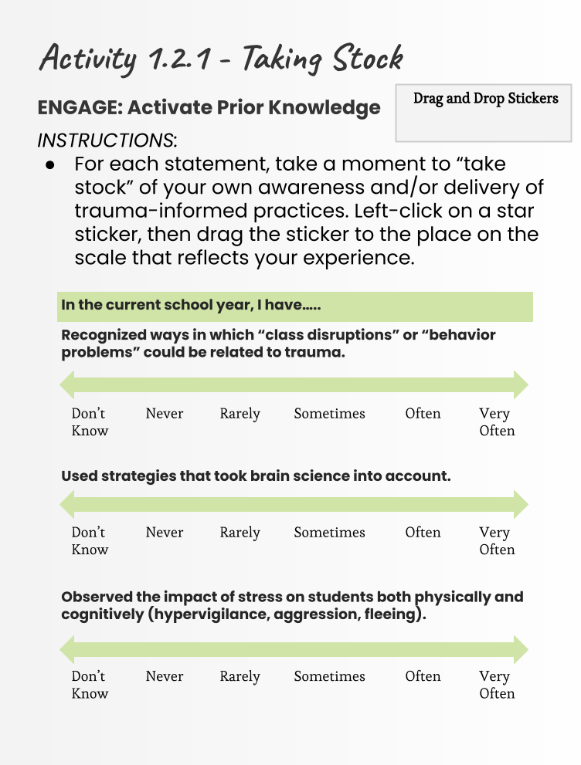
Continued on next page

Slide 22
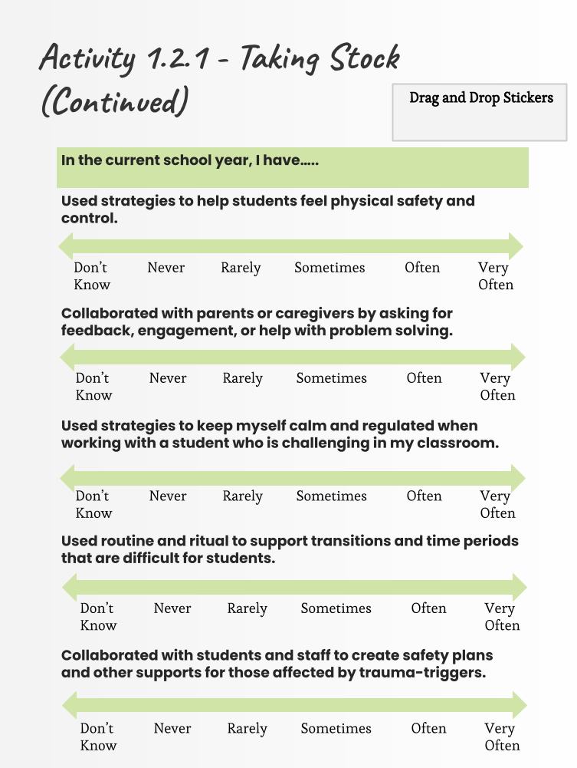
Continued on next page

Slide 23
Activity 1.2.1 - Taking Stock (Continued)
In one sentence, reflect on your current relationship to the term “trauma-informed practices.”
MY CURRENT RELATIONSHIP TO “TRAUMA-INFORMED PRACTICES”:

Slide 24
Activity 1.2.2 - From Priorities to Actions
ESTABLISH: Reflection for Action
INSTRUCTIONS:
Considering what you just learned, what strategies can you connect with the four constants we try to infuse in our teaching?
Use the chart on this page and the following page to document what resonated with you.
An example is provided on each page You can delete the example to enter new text.
CONSTANTS | IN-PERSON STRATEGY | REMOTE/HYBRID STRATEGY
Predictability Teachers can prioritize predictability by establishing routine to build a sense of normalcy, responding in predictable ways, and planning for dysregulation. | Example: I greet each student at the door each morning and let them choose a high five, handshake, hug, or just say hi. (You can delete this example to enter new text.)
Continued on next page

Slide 25
Activity 1.2.2 - From Priorities to Actions (Continued)
CONSTANTS | IN-PERSON STRATEGY | REMOTE/HYBRID STRATEGY
Connection Teachers can prioritize connections by investing in relationships with and between others and being deliberately positive instead of neutral.
Flexibility Teachers can prioritize flexibility by observing and adjusting targets and approaches and allowing for multiple paths towards demonstrating learning.
Empowerment Teachers can prioritize empowering students by providing students with authentic choices, practicing and modeling consent, establishing opt-in policies, and minimizing compliance for compliance-sake. |  | Example: My students always have the choice of unmuting or using the chat in discussions and if they use the chat or voice in their responses. (You can delete this example to enter new text.)

Slide 26
Activity 1.2.3 - Applying Equity-Centered, Trauma-Informed Priorities
This activity is designed to help you apply the four constants that guide equity-centered, trauma-informed teaching.
INSTRUCTIONS:
In Session 1, Activity 1.1.3, you selected a favorite lesson plan that you have taught successfully in the past. Please return to that lesson plan for this activity.
Reviewing your lesson, reflect on how it applies the four constants that guide equity-centered, trauma-informed teaching.
Consider the prompts on the following pages, and complete the tables with changes you might make to enhance your equity-centered, trauma-informed approach to teaching for all your students.
For ideas related to creating predictable, flexible, connected, and student-empowered learning environments, take a look at the Extend section of this session, which contains resources specific to these four constants.
NOTE: This task is designed to inspire reflection. As you complete this activity, please keep in mind that equity-centered, trauma-informed teaching is not a one-time adjustment, but a series of ongoing, intentional decisions and interactions that center your students.
Continued on next page

Slide 27
Activity 1.2.3 - Applying Equity-Centered, Trauma-Informed Priorities (Continued)
CONSTANTS | How can you create a learning environment and use teaching strategies prioritizing…? | How does this action or strategy align with an equity- centered, trauma- informed approach to teaching? | How might this strategy be delivered in a remote or hybrid learning environment?
Predictability
Flexibility
Connectivity
Student Empowerment
Continued on next page

Slide 28
Activity 1.2.3 - Applying Equity-Centered, Trauma-Informed Priorities (Continued)
CONSTANTS | What might “get in the way” of you making this adjustment to the learning activity? | How might you simplify the activity or create a workaround that allows you to focus on what matters most?
Predictability
Flexibility
Connectivity
Student Empowerment

Slide 29
Session 03
Building Classroom Community Across Learning Environments

Slide 30
Key Terms
TERM | WORKING DEFINITION | MY NOTES AND QUESTIONS
Classroom Community | An emotionally and physically safe and supportive learning environment that promotes all students’ social and emotional development
Connectedness | Being connected with others means having relationships with others who understand and care about you. Relationships are key to being connected with others.
Emotional Climate | The tone or mood of a particular setting.
Empowerment | Giving students voice and choice and allowing them to participate in shared decision-making.
Metacognition | Thinking about thinking or becoming aware of one’s knowing.

Slide 31
Activity 1.3.1 - Climate Check
ENGAGE: Activate Prior Knowledge
There are TWO activity options for Activity 1.3.1.
Your first option is Activity 1.3.1a.
Your second option is Activity 1.3.1b.
You need to complete only one option for this activity - your choice! Take a look at both activities, select the one you want to work on, and then complete your selected activity for 1.3.1 - Climate Check.
Continued on next page

Slide 32
Activity 1.3.1 a - Climate Check
ENGAGE: Activate Prior Knowledge
INSTRUCTIONS:
For each statement, drag and drop an arrow sticker by “true” or “false.”
When done, see the next page for answers.
Drag and Drop Stickers
Fostering a positive climate and sense of community for students in educational settings has been linked with retention and academic success. | True | False
Students’ perception of climate rests on how well teachers establish an environment in which mutual interaction is valued, encouraged, and supported. | True | False
Students’ interactions with the teacher are more important than interactions with other students. | True | False
In a learning community, students provide each other with social support but not academic support. | True | False
Continued on next page

Slide 33
Activity 1.3.1a - Climate Check (Continued)
ANSWER KEY:
Delete or move the yellow box below to reveal the correct answers!
Fostering a positive climate and sense of community for students in educational settings has been linked with retention and academic success. | True | False
Students’ perception of climate rests on how well teachers establish an environment in which mutual interaction is valued, encouraged, and supported. | True | False
Students’ interactions with the teacher are more important than interactions with other students. | True | False
In a learning community, students provide each other with social support but not academic support. | True | False
Delete or move this box to reveal answers!

Slide 34
Activity 1.3.1b - Climate Check
ENGAGE: Activate Prior Knowledge
INSTRUCTIONS:
Reflect on your own classroom environments (in-person, remote, and/or hybrid). Using this CASEL rubric, assess where you are in the process of building a supportive classroom environment.
Use the space below to jot down any notes.
MY NOTES:

Slide 35
Activity 1.3.2 - Match a Strategy
ESTABLISH: Reflection for Action
INSTRUCTIONS:
Considering what you just learned, use the chart on the next page to document and reflect on what resonated with you.
An example is provided below.
Use the “Phases of Instruction Key” for Column 2.
PHASES OF INSTRUCTION KEY
Phase 1: Self-Care | Phase 5: Connections During the Lesson
Phase 2: Setting the Stage | Phase 6: Students Drive the Learning
Phase 3: Welcoming Your Learners | Phase 7: Closing Time
Phase 4: Warming Up the Think Tank | Phase 8: Communicating with Families
WHAT STRATEGIES CAN YOU APPLY TO YOUR DIFFERENT CLASSROOM MODALITIES? | TO WHAT PHASE OF INSTRUCTION DOES THIS STRATEGY APPLY? | WHAT DOES THIS LOOK LIKE FOR STUDENTS ACROSS LEARNING ENVIRONMENTS?
Using Class Dojo or Group Me | Phase 8: Communicating with Families | Need to provide flexible communication for families' varied work schedules, unfamiliarity w/tech, time constraints
Continued on next page

Slide 36
Activity 1.3.2 - Match a Strategy (Continued)
WHAT STRATEGIES CAN YOU APPLY TO YOUR DIFFERENT CLASSROOM MODALITIES? | TO WHAT PHASE OF INSTRUCTION DOES THIS STRATEGY APPLY? | WHAT DOES THIS LOOK LIKE FOR STUDENTS ACROSS LEARNING ENVIRONMENTS?

Slide 37
Activity 1.3.3 - Test Drive Technology
INSTRUCTIONS:
For each of the eight instructional phases, identify a community-building strategy you would like to implement and a technology app/tool to help you implement the strategy.
Some apps/tools you might want to consider:
Bitmoji Classroom | Miro
Canva | Padlet
PHASE | COMMUNITY- BUILDING STRATEGY | TECHNOLOGY TO TEST DRIVE
Phase 1: Self-Care
Phase 2: Setting the Stage
Phase 3: Welcoming Your Learners
Phase 4: Warming up the Think Tank
Continued on next page

Slide 38
Activity 1.3.3 - Test Drive Technology (Continued)
Some apps/tools you might want to consider:
Bitmoji Classroom | Miro
Canva | Padlet
PHASE | COMMUNITY- BUILDING STRATEGY | TECHNOLOGY TO TEST DRIVE
Phase 5: Connections During the Lesson
Phase 6: Students Drive the Learning
Phase 7: Closing Time
Phase 8: Communicating with Families
Continued on next page

Slide 39
Activity 1.3.3 - Test Drive Technology (Continued)
Finally, pick one of the strategies and technologies you entered into the tables on the previous pages and go for a “test drive.”
For example, you may want to try building a Bitmoji library of self-care applications for Phase 1.
Summarize your technology test drive experience below.
MY TEST DRIVE SUMMARY:

Slide 40
Session 04
Engaging Students Anywhere

Slide 41
Key Terms
TERM | WORKING DEFINITION | MY NOTES AND QUESTIONS
Affective Dimension | Emotional dimension of learning which includes interest, relationships, and sense of belonging; observable evidence may include engaging in discussions, posing questions, seeking help, and exhibiting curiosity.
Behavioral Dimension | Observable academic actions, specifically the level of participation and submission of assignments; overt behaviors may include raising a hand, completing tasks, tracking the speaker, and following procedures
Cognitive Dimension | Effort students put forth to master content, seek, challenge, and self-regulate; observable evidence may include planning, monitoring progress, setting goals, and solving problems.
Continued on next page

Slide 42
Key Terms (Continued)
TERM | WORKING DEFINITION | MY NOTES AND QUESTIONS
Culturally Responsive and Sustaining Education | Student-centered learning environments that affirm cultural identities; foster positive academic outcomes; develop students’ abilities to connect across lines of difference; elevate historically marginalized voices; empower students as agents of social change; and contribute to individual student engagement, learning, growth, and achievement through the cultivation of critical thinking
Student Engagement | A student's willingness, need, and desire to participate and be successful in the learning process

Slide 43
Activity 1.4.1 - Common Ground
ENGAGE: Activate Prior Knowledge
INSTRUCTIONS:
Reflect on the scenarios below.
Use the Venn diagram on the following page to enter your reflections corresponding to each numbered question.
In-Person Instruction
Recall a time when your students were exhibiting signs of engagement during in-person instruction.
What were your students doing to display engagement?
To what do you attribute their engagement?
Remote/Hybrid Instruction
Now recall a time when your students were exhibiting signs of engagement during remote/hybrid instruction.
What were your students doing to display engagement?
To what do you attribute their engagement?
Common Ground
Reflect on both scenarios.
Are there any common themes? What does this reveal about student engagement in different learning environments?
Continued on next page

Slide 44
Activity 1.4.1 - Common Ground (Continued)
5.
In-Person Instruction
What were your students doing to display engagement?
To what do you attribute their engagement?
Remote Instruction
What were your students doing to display engagement?
To what do you attribute their engagement?
Common Ground
Are there any common themes? What does this reveal about student engagement in different environments?

Slide 45
Activity 1.4.2 - Track Your Learning
ESTABLISH: Reflection for Action
This activity is designed to help you construct meaning from your selected resource(s) and consider implications for your practice. The activity is adapted from a School Reform Initiative protocol, which is available on their website.
INSTRUCTIONS:
As you review your selected material, ask yourself the following:
What are the key points?
What connections can you make about student engagement across all learning environments?
What concrete strategies will you try?
What ideas would you like to further explore?
Enter your responses in the chart on the following page.
Continued on next page

Slide 46
Activity 1.4.2 - Track Your Learning (Continued)
KEY POINTS | CONNECTIONS
What are the key points? | What connections can you make about student engagement across all learning environments?
TAKEAWAY STRATEGIES | FURTHER EXPLORE
What concrete strategies will you try? | What ideas would you like to further explore?

Slide 47
Activity 1.4.3 - Student Engagement Look-Fors Checklist
INSTRUCTIONS:
Create a tool that you can use to check for student engagement across learning environments.
This can be a “look fors” checklist or an observation tool indicating students are engaged in the content across modalities.
Consider using the template below and on the following page to build your tool.
Drag and Drop Stickers for Checklist
ACROSS ALL LEARNING MODALITIES (IN-PERSON, REMOTE, ETC.)
Look-For | Dimension (Behavioral, Affective, Cognitive) | Evidence | Present | Not Present
Continued on next page

Slide 48
Activity 1.4.3 - Student Engagement Look-Fors Checklist (Continued)
Drag and Drop Stickers for Checklist
IN-PERSON INSTRUCTION
Look-For | Dimension (Behavioral, Affective, Cognitive) | Evidence | Present | Not Present
REMOTE/HYBRID INSTRUCTION
Look-For | Dimension (Behavioral, Affective, Cognitive) | Evidence | Present | Not Present

Slide 49
Session 05
Planning for Instruction Across Learning Environments

Slide 50
Key Terms
TERM | WORKING DEFINITION | MY NOTES AND QUESTIONS
Backward Design (also known as Backward Planning or Backward Mapping) | A process that educators use to design learning experiences and instructional techniques to achieve specific learning goals; it helps teachers focus on the goal (learning) rather than the process (teaching).
Deeper Learning | A curriculum and instruction orientation that seeks to support students’ development of skills such as collaboration, communication, and creative problem-solving
Essential Questions | Overarching or topical questions that guide the lesson plan
Learner Variability | The recognition that all students differ. Learning sciences research shows that these differences matter for learning. Variability among learners is the rule rather than the exception.
Continued on next page

Slide 51
Key Terms (Continued)
TERM | WORKING DEFINITION | MY NOTES AND QUESTIONS
Resilient Design for Learning | A three-principle framework for implementing resilient pedagogy that includes planning for extensibility, flexibility, and redundancy
Resilient Pedagogy | The ability to facilitate learning experiences that are adaptable to fluctuating conditions and disruptions and across learning environments
Universal Design for Learning (UDL) | An educational framework that guides the development of flexible learning environments and learning spaces that can accommodate individual learning differences

Slide 52
Activity 1.5.1 - Forward or Backward?
ENGAGE: Activate Prior Knowledge
We can plan in two directions: forward or backward.
Forward planning is familiar. Teachers
identify a topic or content that needs to be taught,
plan a sequence of lessons/activities to teach that content, and
create an assessment to measure the learning.
Backward planning is one strategy we will learn more about in this session. In backward planning, teachers
identify the core skills that students should gain,
design assessments that allow students to show what they have learned, and
develop activities, materials, and resources that lead to the essential skills and understanding.
INSTRUCTIONS:
As a thought exercise, think about a lesson you typically plan in a forward (traditional) manner.
Sketch how the planning would look if you used a backward planning approach. Use the table on the following page.
An example is provided on the following page, as well. After you’ve read the example, you can delete it to create more space to write.
Continued on next page

Slide 53
Activity 1.5.1 - Forward or Backward? (Continued)
GOAL | EVIDENCE OF SUCCESS | LEARNING EXPERIENCE
Measurable Objectives | Assessment | Activities and Instruction
Grade 3 geometry: Students will be able to identify and distinguish between examples and non-examples of quadrilaterals. | Formative assessments: Observe sorting and drawing activities throughout the lesson. Summative: In-class matching worksheet collected as a document of learning. | Students will use construction paper quadrilateral kits (rhombus, rectangle, square). Pairs of students will design quadrilaterals that meet the definition but are not examples of a rhombus, rectangle, or square.

Slide 54
Activity 1.5.2 - Revise a Lesson
ESTABLISH: Reflection for Action
INSTRUCTIONS:
Considering what you just learned, think about a lesson that you currently teach.
In the table on the next page, decide if that lesson would benefit from using principles of essential questions, backward design, or universal design for learning (UDL). Which strategy are you most likely to implement?
Then think of a way that you might extend this lesson to reach students across all learning environments.
An example is provided in the table on the following page to get you started. After you’ve read the example, you can delete it to create more space to write.
Continued on next page

Slide 55
Activity 1.5.2 - Revise a Lesson (Continued)
Lesson (Brief Summary) | Apply one of these strategies: Essential Questions Backward Design UDL | How might this reach students across all learning environments?
Example: A lesson on understanding figurative language through Maya Angelou’s poem Phenomenal Woman | This lesson would benefit from applying UDL, especially multiple means of action and expression. How can all of my students express their knowledge of figurative language? (Write a poem, record a rap song, create a painting or other artistic rendering) | Students in all learning environments can team up to collaborate depending on their preferred means of action and expression - for example, those who want to create a visual might do a Google Slideshow together, while some might write a poem, collectively posting ideas on Jamboard.

Slide 56
Activity 1.5.3 - Applying Design Strategies
INSTRUCTIONS:
Revisit the lesson plan you identified in Session 1 and worked with again in Session 2.
Review your lesson plan again through the lens of instructional planning across learning environments:
Whether we teach in person or online, are we planning with the end in mind?
Do we know what is essential to the lesson?
Do we center the learning of students by developing multiple means of engagement, representation and expression?
Complete the table on the following page to guide your review of your lesson plan.
In the reflection/evidence column, indicate how your lesson currently does or does not address each consideration.
In the ideas for improvement column, indicate ways that your lesson might be improved.
Continued on next page

Slide 57
Activity 1.5.3 - Applying Design Strategies (Continued)
Be sure to think about the three principles of resilient pedagogy – extensibility, flexibility, and redundancy – as you draft ideas for improvement.
CONSIDERATION | REFLECTION/EVIDENCE | IDEAS FOR IMPROVEMENT
Is this lesson planned with the end in mind?
Do you know what is essential to the lesson?
Do you center the learning of students by developing multiple means of engagement, representation and expression?

Slide 58
Session 06
Excellent Teaching Happens Everywhere

Slide 59
Key Terms
TERM | WORKING DEFINITION | MY NOTES AND QUESTIONS
Portability | The ability to be easily carried or moved
Resilient | Able to withstand or recover quickly from difficult conditions
Restorative Practice | Focuses on resolving conflict, repairing harm, and healing relationships
Teacher Clarity | Communicating the learning intention and success criteria so students can identify where they are going in their learning, how they are progressing, and where they will go next, thus providing students enough clarity to own their learning

Slide 60
Activity 1.6.1 - What Are My Go-To’s?
ENGAGE: Activate Prior Knowledge
INSTRUCTIONS:
Take a moment to consider a few of your go-to teaching practices that work across learning environments.
Use the chart on the following page to describe how this practice looks in-person and remote.
An example is provided below.
WHAT IT LOOKS LIKE IN-PERSON | TEACHING PRACTICE | WHAT IT LOOKS LIKE REMOTE
When I want to allow my kids to process their thoughts, I have them turn to their elbow partner and take turns responding to the prompt. After a few minutes, I invite students to share either their thoughts or something their partner said that they thought was cool. | Pair-share | On Zoom, I pre-set partners for each day of class. They know they will have a new partner each day. Then when it’s time for pair-share, I whisk them into breakout rooms for two minutes with a visible timer. I pop into one or two breakouts to listen in. Then they can share their own thoughts or something their partner said in the chat or by raising their hand icon.
Continued on next page

Slide 61
Activity 1.6.1 - What Are My Go-To’s?
(Continued)
WHAT IT LOOKS LIKE IN-PERSON | TEACHING PRACTICE | WHAT IT LOOKS LIKE REMOTE
Continued on next page

Slide 62
Activity 1.6.1 - What Are My Go-To’s? (Continued)
Meta Moment: What do the teaching practices you chose have in common that make them nimble and portable? Write your reflection in the space below.

Slide 63
Activity 1.6.2 - Taking Stock of My Teaching Environment
ESTABLISH: Reflection for Action
The three strategies we focused on during this session were
creating a student-centered classroom,
examining how teacher role affects student expectations, and
building relationships that promote a safe and positive environment.
INSTRUCTIONS:
Reflect on your current teaching strategies in these areas and apply what you learned to extend your ideas to teaching across learning environments.
Complete the table on the following page.
Continued on next page

Slide 64
Activity 1.6.2 - Taking Stock of My Teaching Environment (Continued)
Currently, I create a student-centered classroom by…
Moving forward, I can extend these practices across learning environments by…
Currently, I believe that my teacher role is to…
Moving forward, I can ensure that my role is focused on learning outcomes and the evidence of learning across learning environments by…
Continued on next page

Slide 65
Activity 1.6.2 - Taking Stock of My Teaching Environment (Continued)
Currently, I build positive and supportive relationships in my classroom by…
Moving forward, I can ensure that I build and sustain positive and supportive relationships across learning environments by…

Slide 66
Activity 1.6.3 - My Classroom Community
The importance of building classroom community has been highlighted twice now in this module: first in Session 3, which was devoted to building community across modalities, and now in Session 6, which explores high-level teaching practices.
Take this opportunity to detail your existing approach to building classroom community. This may be
a whole-school program that you implement, such as responsive classroom,
a collection of strategies that are tried-and-true for you,
a holistic approach that you use, e.g., restorative practices,
a combination of these options, or
something else.
The purpose of this activity is to make your approach to community building explicit and think about how it operates across modalities.
INSTRUCTIONS:
Complete the table on the following page by answering the prompts.
For your own processing, highlight anything that stands out to you as an element of your approach that is particularly successful.
Continued on next page

Slide 67
Activity 1.6.3 - My Classroom Community (Continued)
Reminder: Highlight anything that stands out to you as an element of your approach that is particularly successful.
Community- Building Activity, Program, or Approach | What are the key elements for remote implementation? | What are the key elements for in-person implementation?

Slide 68
Session 07
Teaching With Technology

Slide 69
Key Terms
TERM | WORKING DEFINITION | MY NOTES AND QUESTIONS
Edtech | Edtech (a combination of "education" and "technology") refers to hardware and software designed to enhance teacher-led learning in classrooms and improve students' education outcomes (EdTech Definition and Uses).
SAMR | SAMR is a framework created by Dr. Ruben Puentedura that classifies four levels of technology integration in learning environments (SAMR Model: A Practical Guide for K-12 Classroom Technology Integration). SAMR stands for substitution, augmentation, modification, and redefinition.
Continued on next page

Slide 70
Key Terms (Continued)
TERM | WORKING DEFINITION | MY NOTES AND QUESTIONS
TPACK | Technological pedagogical content knowledge (TPACK) attempts to identify the nature of knowledge required by teachers for technology integration. At the heart of the framework is the interplay of three forms of knowledge: content knowledge (CK), pedagogical knowledge (PK), and technology knowledge (TPACK Explained).
Triple E | A framework developed by Dr. Liz Kolb that helps educators determine to what extent technology integration supports engagement as well as enhancement and extension of student learning goals (Triple E Framework).

Slide 71
Activity 1.7.1 - My Students’ Interactions with Technology
ENGAGE: Activate Prior Knowledge
The purpose of this activity is to reflect on and creatively express your experiences with integrating technology with your teaching.
INSTRUCTIONS:
Reflect on the following:
How are students in your class interacting with technology in ways that support collaboration and engagement in the learning?
What does your students’ use of technology reveal about your beliefs related to the value of instructional technology?
Using your technology tool of choice (e.g., graphic organizer, digital storytelling, digital mind map, infographic, Flip, social media), create something that represents your reflection.
POST A LINK TO YOUR FINAL CREATION HERE:

Slide 72
Activity 1.7.2 - Choice Board Takeaways
ESTABLISH: Reflection for Action
The purpose of this activity is to support note taking and action planning as a result of engaging with selected resources.
INSTRUCTIONS:
As you interact with your selected resources, use the graphic organizers on the following page to note key points and applications for your practice.
Continued on next page

Slide 73
Activity 1.7.2 - Choice Board Takeaways (Continued)
TECHNOLOGY FRAMEWORK: SAMR
KEY POINT #1 | KEY POINT #2 | KEY POINT #3
HOW I CAN USE THIS FRAMEWORK IN MY PRACTICE:
TECHNOLOGY FRAMEWORK: TRIPLE E
KEY POINT #1 | KEY POINT #2 | KEY POINT #3
HOW I CAN USE THIS FRAMEWORK IN MY PRACTICE:

Slide 74
Activity 1.7.3 - Application for My Practice
The purpose of this activity is to evaluate an example of technology integration in your practice. You’ll apply what you have learned about resilient pedagogy and the technology integration frameworks SAMR and Triple E.
INSTRUCTIONS:
Revisit the lesson plan you identified in Session 1, and worked with again in Sessions 2 and 5. Identify where technology is used or could be used to support resilient design for learning and meet the needs of your learners.
Option 1: If your lesson plan already includes technology, you might use this activity as an opportunity to evaluate how it is used.
Option 2: You might use this activity as an opportunity to plan a new use of technology within the lesson.
After you have reviewed your lesson plan, identify one instance of technology integration to evaluate.
Apply the frameworks you have learned to describe why and how you’re using that technology. Using the appropriate template on the following pages, create a quad chart to capture your analysis.
After you have read a prompt in the quad chart, you may delete it to create space to enter your response.
Continued on next page

Slide 75
Activity 1.7.3 - Application for My Practice (Continued)
Option 1: Evaluate a current technology use.
Describe the instructional context. When in your lesson is this technology used? Who is using this technology (teacher, students, or both)? Why?
Apply the resilient pedagogy framework. How well does this use of technology support designing for extensibility, flexibility, and redundancy? What, if anything, would you do differently in light of this framework?
Name of Technology
Apply the Triple E Framework. How does the use of technology engage, enhance, or extend learning? How do you know? What, if anything, would you do differently in light of this framework?
Apply SAMR. Is this use of technology a substitution, application, modification, or redefinition? How do you know? What, if anything, would you do differently in light of this model?

Slide 76
Activity 1.7.3 - Application for My Practice (Continued)
Option 2: Plan a new technology use.
Describe the instructional context. When in your lesson would this technology be used? Why is it needed? Who would be using this technology (teacher, students, or both)?
Apply the resilient pedagogy framework. How does this technology support designing for extensibility, flexibility, and redundancy?
Name of Technology
Apply the Triple E Framework. How will using this use of technology engage, enhance, or extend learning? What will you look for while students are learning?
Apply SAMR. Is this use of technology substitution, application, modification, or redefinition? How do you know?

Slide 77
Session 08
Shifting with Family Partners

Slide 78
Key Terms
TERM | WORKING DEFINITION | MY NOTES AND QUESTIONS
Two-Way Communi-cation | Two-way communication that comes from both parties in the form of a conversation.
Culturally Responsive and Sustaining Education (CRSE) | A framework that helps educators create student-centered learning environments that affirm racial, linguistic, and cultural identities
Equity Audit | A structured way to assess the degree of equity or inequity in an educational environment
Family Engage- ment | The systematic inclusion of families in activities and initiatives in ways that promote student learning and wellness
Four Constants | An “equity-centered, trauma-informed” approach to designing supportive learning environments prioritizes the four constants: predictability, flexibility, connection, and empowerment

Slide 79
Activity 1.8.1 - Building on Success
ENGAGE: Activate Prior Knowledge
INSTRUCTIONS:
Recall an interaction between you and a student's family that went well, making note of specific strategies, routines, technologies, or interventions that worked.
Jot down at least one success in each category of the chart below.
Two examples are provided, which you can delete after you’ve read them.
Remember, this interaction is with the adult caregivers rather than with your students.
A time I used a predictable routine to good effect: | A time or a way I facilitated connection between me and families or among families:
I always embed a Google translate link in my weekly update to families.
A time I was able to offer a flexible work-around to a family that gave them improved access: | A time I helped amplify a family member’s voice to good effect:
 | I created an organizational flow chart to help my families navigate school and district administration.

Slide 80
Activity 1.8.2 - Removing Barriers to Participation
ESTABLISH: Reflection for Action
INSTRUCTIONS:
Use the table on the following page to think about how you communicate with families about your partnership.
In the first column are possible or common expectations that teachers have of families.
You can delete or add to the list of expectations.
In other words, what kinds of support do you expect caregivers to provide their children to support their schoolwork?
In the second column, note the resources or conditions families need to meet these expectations.
In the third column, what barriers may families encounter in offering support to their children for schoolwork?
In the last column, if there are barriers, what is a supportive work-around that you can offer?
Continued on next page

Slide 81
Activity 1.8.2 - Removing Barriers to Participation (Continued)
Teacher Expectations of Family (Delete or add your own.) | Resources or Conditions Needed by Family to Meet Expectations | Possible Barriers To Meeting Expectations | When Necessary: Is There A Possible Work-Around?
Provide a place for doing schoolwork
Check that schoolwork is completed every night | Example: Work schedule that overlaps with homework time
Ask their children about what they are learning |  | Example: Students may say little. Will update my class Google site weekly for families.
Keep in regular contact with you about their student’s progress
Reach out with any questions that might arise about schoolwork

Slide 82
Activity 1.8.3 - Developing a Warm Welcome
Put your ideas into action and create a functional communication for families that you can use.
INSTRUCTIONS:
Create two “welcome” communications for families, explaining communication routines, e.g., how often you plan to communicate, what types of communication you use, and who to contact in different scenarios.
The objective is to open lines of communication with parents/family members and to create a welcoming environment for them to voice their comments or questions.
Some options are:
Create a brief Flip video. | Create a slidedeck (Slides; PowerPoint).
Create a newsletter using Canva. | Create a website using Google Sites.
Create a Google Classroom for families. | Create a brief voice memo or podcast.
Post a link to your creations below.

Slide 83
Session 09
Designing Meaningful Assessments

Slide 84
Key Terms
TERM | WORKING DEFINITION | MY NOTES AND QUESTIONS
Actionable Feedback | Feedback that is concrete, specific, and useful for producing change or improvement in the process or product
Authentic Assessment | Measures real-world application of knowledge and skills and requires innovative thinking or problem-solving on behalf of the learner
Formative Assessment | Informal or formal feedback during the learning process that informs instruction
Rubric | A scoring guide used to evaluate performance, a product, or a project. It has three parts: (1) performance criteria, (2) a rating scale, and (3) indicators. For you and your students, the rubric defines what is expected and what will be assessed.
Summative Assessment | Formal feedback at the conclusion of the unit of study, i.e., an outcome evaluation
Continued on next page

Slide 85
Activity 1.9.1 - Assessment Chart
ENGAGE: Activate Prior Knowledge
INSTRUCTIONS:
Think of three assessments that you currently use in the classroom. Enter those into the first column of the table below.
In the following columns, write whether these are formative or summative and whether they require high, low, or no technology.
On the next page, jot down some notes about which of these assessments is the most useful to you. In other words, which of these assessments provide you with actionable feedback, or with the feedback needed for you to make instructional changes to your lessons?
ASSESSMENT | TYPE (FORMATIVE OR SUMMATIVE) | TECH NEEDS (HIGH, LOW, OR NO TECH NEEDED)
Continued on next page

Slide 86
Activity 1.9.1 - Assessment Chart (Continued)
Which of these three assessments is the most useful to you? In other words, which of these assessments provide you with actionable feedback, or with the feedback needed for you to make instructional changes to your lessons?
MY NOTES:

Slide 87
Activity 1.9.2 - Reflection
ESTABLISH: Reflection for Action
Now that you have reviewed your selected resource(s), take a moment to think about
how you use feedback,
how you can make your assessments authentic, and
how you can embed those authentic assessments across learning environments.
INSTRUCTIONS:
Using the chart on the following page, answer the following questions:
What is a typical task or assessment that you use to assess student knowledge?
Select two different tasks or assessments.
How can you turn that task into an authentic task?
How can that authentic task translate across learning environments?
An example has been provided for you on the following page. You can delete the example to create more space, if needed.
Continued on next page

Slide 88
Activity 1.9.2 - Reflection (Continued)
Task/ Assessment | How can you turn that task into an authentic task? | How can that authentic task translate across learning environments?
Example: A multiple- choice test on the battles of the American Revolution | A student- written newspaper highlighting the battles of the American Revolution | Students can synchronously work together on a Canva template, creating a newspaper set during the Revolutionary War, using facts from the unit.

Slide 89
Activity 1.9.3 - Design a Rubric
INSTRUCTIONS:
Revisit the lesson plan you’ve been working with throughout this module, or select one of the authentic tasks you worked on in Activity 1.9.2.
Design a rubric for that assessment using the table on the following page. The table walks you through six steps and guiding questions for designing a rubric (adapted from "How To Create a Rubric in 6 Steps") and provides space for your notes about your rubric.
Continued on next page

Slide 90
Activity 1.9.3 - Design a Rubric (Continued)
Six Steps for Designing a Rubric
STEP | ASK YOURSELF… | RUBRIC NOTES
Step 1: Define your goal | What standards must the students meet in order to achieve acceptable or exceptional performance? How do I want to assess performance? How will I break down my expectations for this project? Are all of the tasks equally important? Do I want to give one final grade on the project or a cluster of smaller grades based on several criteria? Am I grading based on the work or on participation? Am I grading on both? How detailed do I want my feedback to be?
Step 2: Decide if holistic or analytic rubric | Holistic - Letter grades or a number range (e.g., 1-5) with descriptions for each score Analytic - Multiple levels and a variety of descriptive criteria
Continued on next page

Slide 91
Activity 1.9.3 - Design a Rubric (Continued)
Six Steps for Designing a Rubric
STEP | ASK YOURSELF… | RUBRIC NOTES
Step 3: Determine your criteria | What standards or learning objectives will you address? What knowledge and/or skills will students need to develop? What measurable expectations will you look for?
Step 4: Develop performance levels | How many levels do you want to use? Will you use a 4-3-2-1 scale? Will you use words as well, such as 4-Exemplary, 3-Proficient, etc.? If so, what will each of these mean?
Continued on next page

Slide 92
Activity 1.9.3 - Design a Rubric (Continued)
Six Steps for Designing a Rubric
STEP | ASK YOURSELF… | RUBRIC NOTES
Step 5: Develop descriptive criteria | Start with a score of “proficient.” What does proficiency look like? How would you describe it when you saw it? What parts does it have? Build the rest around what proficiency looks like. What would “exceeds” or “excels” look like? What would just below proficiency (some understanding) look like? What would minimal understanding look like?
Step 6: Revise rubric | Go back to your standards and learning objectives. Are they aligned? Are they measurable? Is everything clear for all students? Share your standards and objectives with students and ask if anything is unclear. Share your standards and objectives with a colleague to get a second opinion.

Slide 93
Session 10
Reflection and Continuous Improvement

Slide 94
Key Terms
TERM | WORKING DEFINITION | MY NOTES AND QUESTIONS
Metacognition | Awareness and understanding of one's own thought processes
Plan-Do-Study-Act (PDSA) cycle | A PDSA cycle has four phases that help you plan for a desired change in your practice and collect evidence as you go to determine if you want to adopt the practice.

Slide 95
Activity 1.10.1 - Plan-Do-Study-Act
ENGAGE: Activate Prior Knowledge
INSTRUCTIONS:
In this session, we will learn about the four phases of a Plan-Do-Study-Act (PDSA) cycle. A PDSA cycle is a way to plan for a change in your practice, test out the change, study the results, and then make a data-informed decision about next steps.
Let’s test your existing knowledge. For each step in the table on the following page, drag and drop a star sticker to the appropriate column for its placement in the Plan-Do-Study-Act (PDSA) cycle.
For example, the first step in the table on the following page is “Make Predictions”. That is a step in the Plan phase of PDSA cycle. A star is placed in the table to indicate that answer.
Remember: We are warming up the think tank as an exercise!
Continued on next page

Slide 96
Activity 1.10.1 - Plan-Do-Study-Act (Continued)
Drag and Drop Star Stickers
An answer key is provided on the following page.
ELEMENT | PLAN | DO | STUDY | ACT
Make Predictions
Collect Data
Compare Results to Predictions
Adopt, Abandon, Adapt
Determine Next Steps
Create Questions
Reflect on Data Collected
Continued on next page

Slide 97
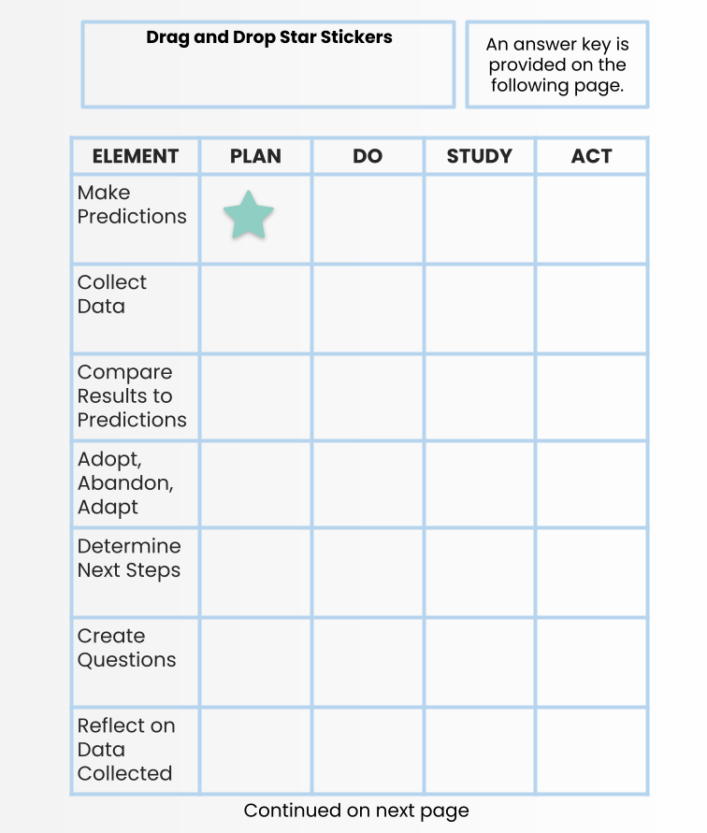
Activity 1.10.1 - Plan-Do-Study-Act (Continued)
Continued on next page

Slide 98
Activity 1.10.1 - Plan-Do-Study-Act (Continued)
Answer Key
ELEMENT | PLAN | DO | STUDY | ACT
Make Predictions
Collect Data
Compare Results to Predictions
Adopt, Abandon, Adapt
Determine Next Steps
Create Questions
Reflect on Data Collected
Delete or move this box to reveal answers!

Slide 99
Activity 1.10.2 - Module Goals Self-Assessment
ESTABLISH: Reflection for Action
INSTRUCTIONS:
Rate your level of mastery of some of the key concepts from Module 1: Shifting Across Learning Environments by placing an “X” under novice, proficient, or expert in the chart on the following pages.
Use the last column of the chart to note your next step related to each key concept. Enter C, E, or P according to the key below.
C = Change my practice
E = Explore further
P = Pause for now
Note: There are no right or wrong answers to this self-assessment. This activity is intended to provide you with data to reflect upon areas requiring more development or areas suitable for implementation as part of a PDSA cycle.
Continued on next page

Slide 100
Activity 1.10.2 - Module Goals Self-Assessment (Continued)
Session | TALE Concept | Rating 1 = Novice 2 = Proficient 3 = Expert | Next Step C = Change my practice E = Explore further P = Pause for now
Session 1: From ERT to TALE | I understand the principles of resilient pedagogy.
Session 1: From ERT to TALE | I can apply the concepts of extensibility, flexibility and redundancy in my lesson planning.
Session 2: The 4 Constants Across Learning Environments | I can create equity-centered, trauma-informed learning environments by using predictability, flexibility, connection, and empowerment.
Session 3: Building Classroom Community Across Learning Environments | I can build positive learning environments across modalities, using some or all of the eight phases of instruction.
Continued on next page

Slide 101
Activity 1.10.2 - Module Goals Self-Assessment (Continued)
Session | TALE Concept | Rating 1 = Novice 2 = Proficient 3 = Expert | Next Step C = Change my practice E = Explore further P = Pause for now
Session 4: Student Engagement Across Learning Environments | I understand the premise of fostering student-centered approaches to engagement across learning environments.
Session 5: Planning for Instruction Across Learning Environments | I can identify essential questions and understand the principles of backward design and universal design for learning.
Session 6: Excellent Teaching Happens Everywhere | I can implement portable teaching practices that are student-centered, learning-focused, and emotionally intelligent across learning environments.
Session 7: Teaching with Technology | I understand the SAMR Model and the Triple E Framework for using technology.
Continued on next page

Slide 102
Activity 1.10.2 - Module Goals Self-Assessment (Continued)
Session | TALE Concept | Rating 1 = Novice 2 = Proficient 3 = Expert | Next Step C = Change my practice E = Explore further P = Pause for now
Session 8: Shifting with Family Partners | I can use the principles of predictability, flexibility, connection, and empowerment in establishing partnerships with families.
Session 9: Designing Meaningful Assessments | I can create feedback and authentic assessments that help students make meaning out of their learning.

Slide 103
Activity 1.10.3 - Reflections
INSTRUCTIONS:
Reflect on your experience in this module by responding to the prompts below. You may share your reflection in your preferred mode (e.g. written, podcast, selfie video, 3-panel cartoon, haiku deck presentation, etc.).
Why is it important to understand and plan using resilient pedagogy?
Did this experience change your practice? Why or why not?
As you move forward in your professional learning, what additional information are you interested in? What might your next step be as you continue?
ENTER YOUR REFLECTIONS OR A LINK TO YOUR CREATION HERE:

Slide 104
About the TALE Academy
The TALE Academy is a series of virtual learning experiences available to all New York State educators and offers a rich array of resources on topics related to teaching across learning environments (TALE). The TALE Academy is built upon the work New York State educators carried out during emergency remote teaching (ERT) throughout the COVID-19 pandemic and extends it toward the future. TALE invites educators to think beyond online learning to consider a broader perspective on teaching and learning that encompasses teaching across multiple environments (in-person, remote, and hybrid).
About Teaching in Remote/Hybrid Learning Environments
The TALE Academy is a part of a broader New York State Education Department (NYSED) initiative known as Teaching in Remote/Hybrid Learning Environments (TRLE). In July 2020, NYSED was awarded funding through the United States Department of Education’s Education Stabilization Fund-Rethink K-12 Education Models Grant to implement TRLE – a three-year project to build the capacity of teachers and educational leaders to effectively implement remote/hybrid learning for all students. To learn more, visit NYSED’s TRLE website: http://www.nysed.gov/trle.
The content of the TALE Academy was produced in whole or in part with funds from Contract C014452 and does not necessarily reflect the position or policy of the New York State Education Department (NYSED), nor does mention of trade names, commercial products, or organizations imply endorsement by NYSED. In addition, NYSED, its employees, officers, and agencies make no representations as to the accuracy, completeness, currency, or suitability of the content herein and disclaim any express or implied warranty as to the same.
Slide template: slidesmania.com

